Slide 1
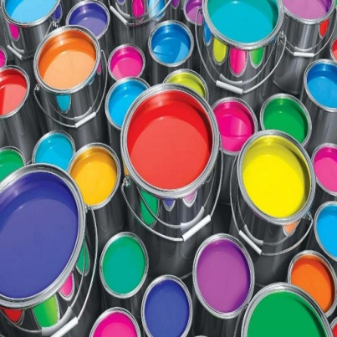
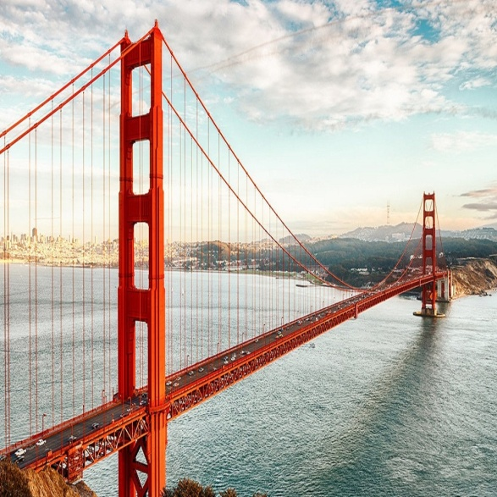
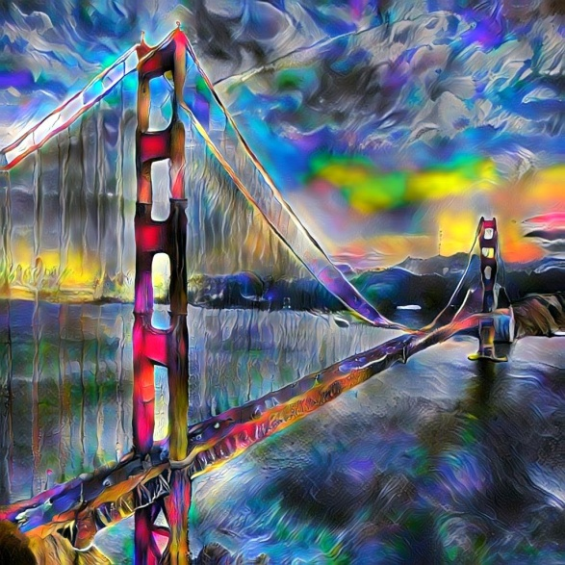
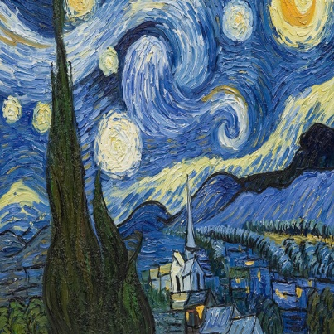

Universal Style Transfer via Feature Transform
+
=
Eyal Waserman
Carmi Shimon
Li et al. NIPS 2017
Notes:
- Talk about background for Style Transfer, look at related work and add

Slide 2
Universal Style Transfer via Feature Transform
PyTorch Tool for Style Transfer available at https://github.com/eyalw711/universal_style_transfer
Innovative technique to enhance style transfer effect
Innovative new techniques to merge styles more efficiently
Eyal Waserman
Carmi Shimon

Slide 3
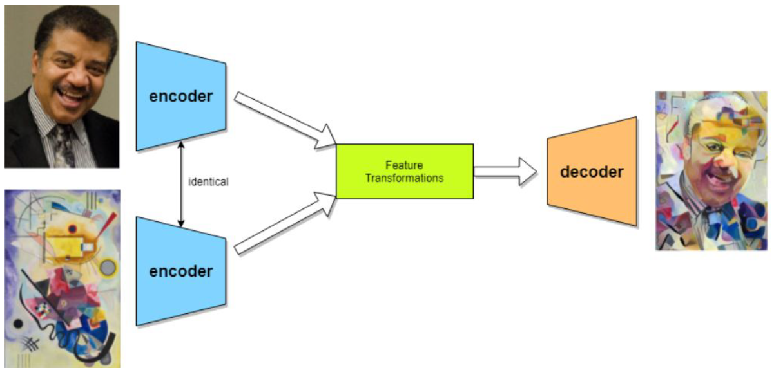
Stylization based on Feature Transform
Image source: https://ai.googleblog.com/2016/02/exploring-intersection-of-art-and.html
Notes:
Our algorithm for UST is based on encoder-decoder neural network.
Explain what is content, what is style, talk about decoder, encoder and the need of them. What is Feature Transform

Slide 4
WCT
Whitening:
Center
Notes:
How do we use Feature Transform such as WCT for ST. Whitening, Coloring

Slide 5
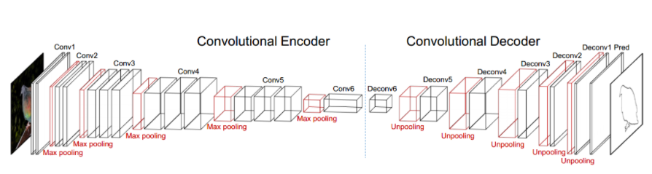

Feature Transform Using VGG-19 Encoder-Decoder
Image source: Li et al.

Slide 6
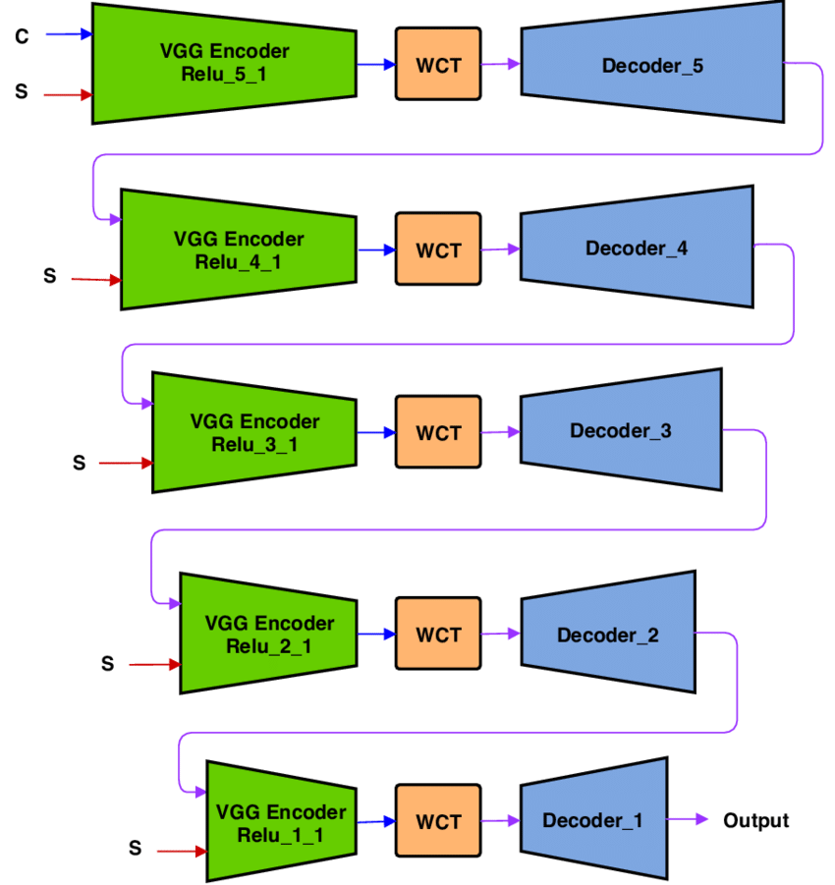
Algorithm Architecture
Image source: https://www.researchgate.net/figure/Universal-Style-Transfer-architecture-with-the-whole-multi-level-pipeline-Each-level-of_fig3_327495907

Slide 7
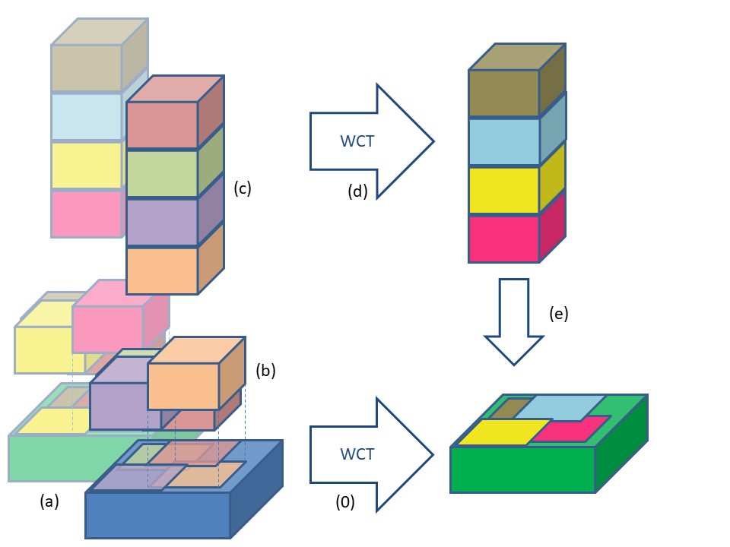
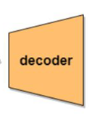
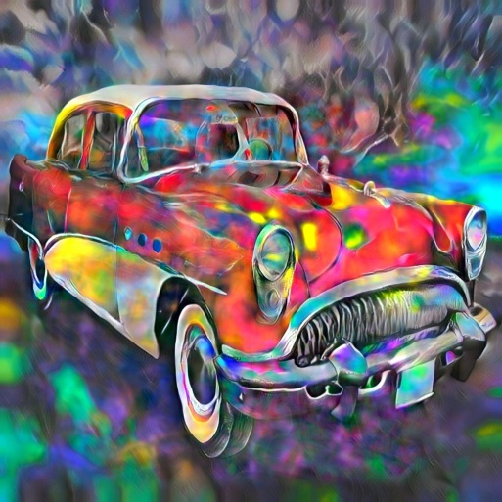
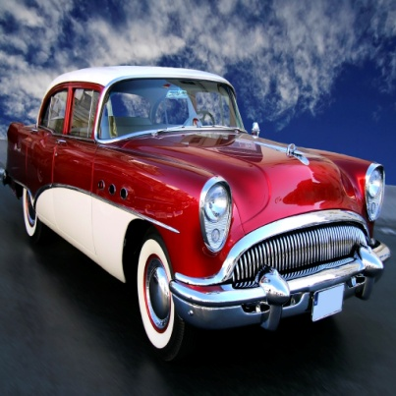
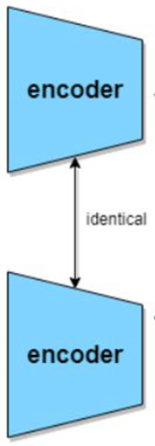
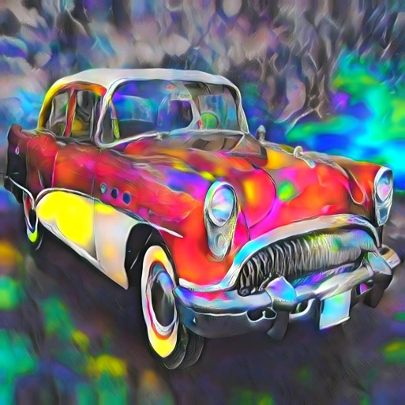

Stylization Boosting
Boost
No Boost

Slide 8
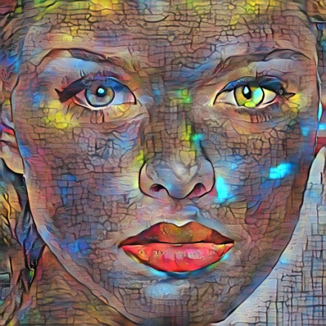
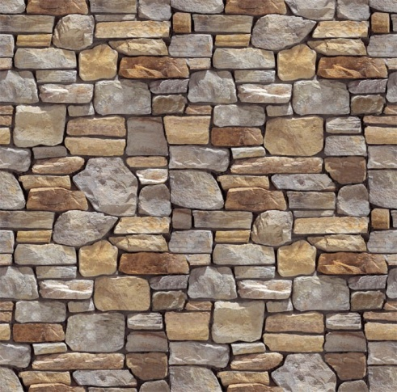
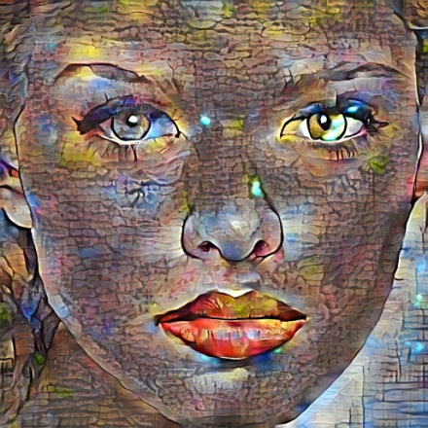
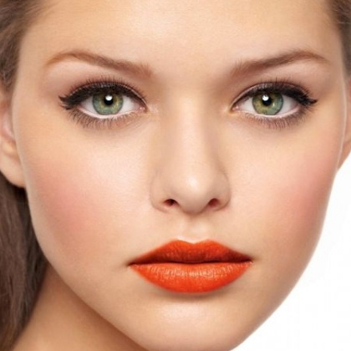
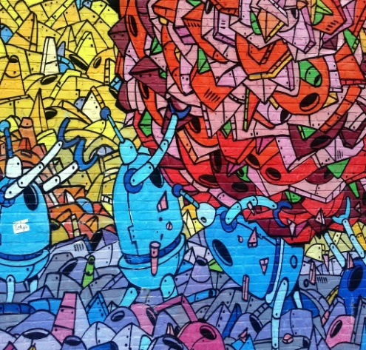
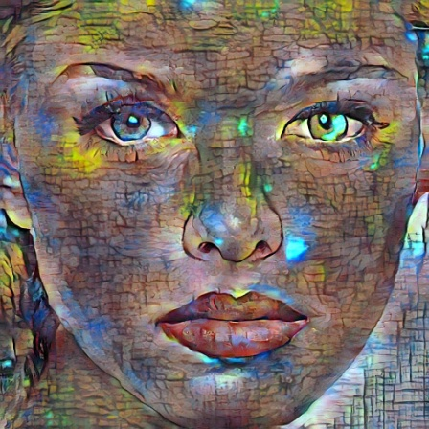
Two Style Merging
Interp. Merge
Level Merge
Channel Merge

Slide 9

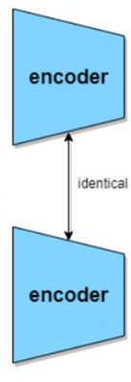



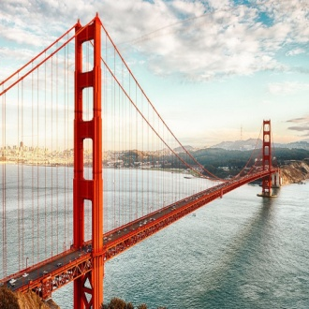

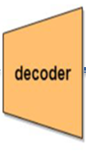


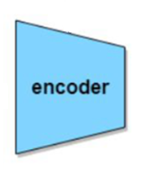







Original Merge
$$f_{s_{1}}$$
Style1
$$f_{cs_{1}}$$
$$f_{c}$$
$$β⋅f_{cs_{1}}+\left(1−β\right)f_{cs_{2}}$$
Content
$$f_{cs_{2}}$$
$$f_{s_{2}}$$
Style2
Deep feature channels

Slide 10
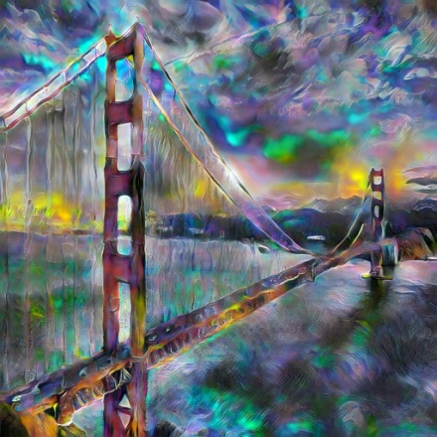
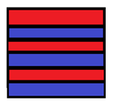





Channel Merge
$$f_{s_{1}}$$
$$f_{s_{1,2}}$$
Style1
$$f_{s_{2}}$$
$$f_{cs}$$
Style2
$$f_{c}$$
Content
Deep feature channels

Slide 11
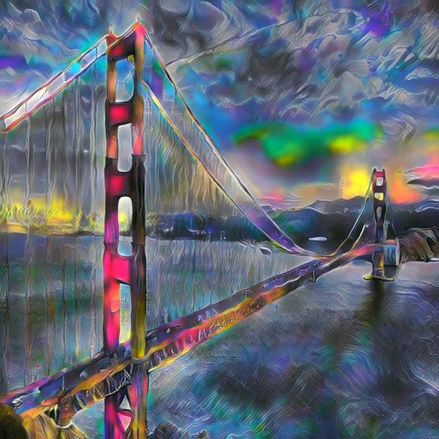

Interpolation Merge
Deep feature channels

Slide 12
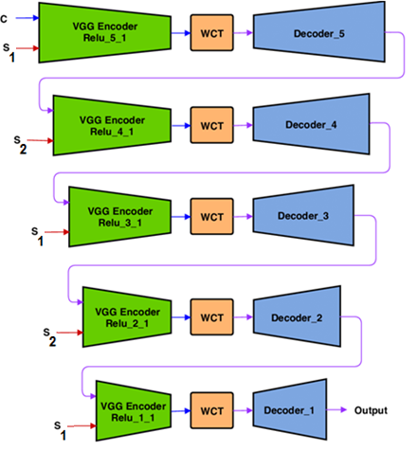
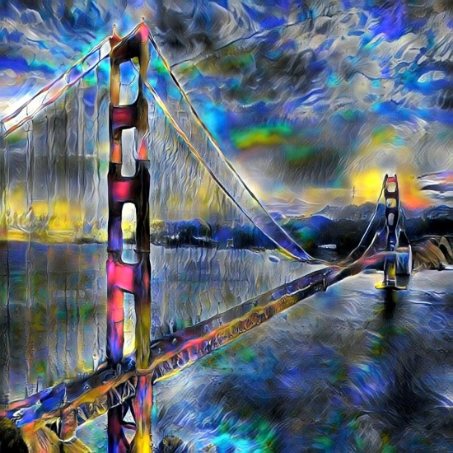
Level Merge

Slide 13
Questions?
Clone Tool from: https://github.com/eyalw711/universal_style_transfer
Eyal Waserman
Carmi Shimon

